Slide 1



International (The “I” in CKI)
Capital District Circle K International
Membership Development & Education Committee
May 2014

Slide 2
Circle K INTERNATIONAL
CKI operates under multiple rings of support:
Club level (club officers, members)
District Level (district officers, LTGs, committees)
International Level (International President, Trustees, International committees)

Slide 3
International Leaders
Elected each summer at International Convention
Students serve in their positions for one year:
International President
International Vice President
7 International Trustees

Slide 4
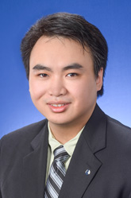
International President
Daniel Tsang
Loyola University of Chicago
Helps lead the I-Board in identifying the critical issues facing the organization and evaluating strategies to to support the organization’s mission.

Slide 5
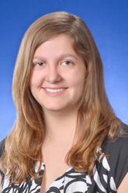
International Vice President
Amelia Ahnert
The Pennsylvania State University
Supports the International President and sends out a weekly newsletter to members via email.

Slide 6
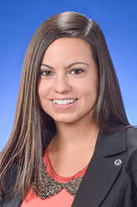
International Trustee
Danielle Sammut
The College of New Jersey
Representing Subregion F:
Capital
Eastern Canada
New England
New Jersey
New York
Notes:
There are seven subregions of CKI: A-G
Districts are grouped into subregions in a way similar to how clubs are grouped into divisions within each district

Slide 7
Getting Involved
So how can members (like YOU) get involved on the International level?
International Committees
International Convention
Leadership Academy

Slide 8
International Committees
Similar to District Committees, the International Board also has committees that members can join:
Service
Kiwanis Family Relations
Membership and Marketing
Large Scale Service Project (LSSP)
Applications to join committees go out in July so keep an eye on your email!

Slide 9

International Convention (ICON)
This year, International Convention and Large Scale Service Project (LSSP) are being combined into a super fun hybrid event called CKIx!
It will take place in Nashville, Tennessee from June 17-22, 2014 at the Loews Vanderbilt Hotel.
Notes:
Check out these links for more information: http://circlek.org/Leadership/Conventions/InternationalConvention/Nashville2014.aspx
https://docs.google.com/a/cdcki.org/document/d/1M5MssXaJuwNvVwzm-49LjgjU8K4RbL5-S8C53rRLpAk/edit
Registration Deadlines and Fees:
$395 Regular Registration (May 2-June 1)
$495 Late/on-site registration (After June1)

Slide 10
Leadership Academy
Want to develop your skills as a servant leader? Check out CKI’s Leadership Academy
July 27-August 1, 2014
Morgantown, Indiana
Registration is $195, which includes food and lodging.
Capital District is sponsoring a scholarship for one member to attend Leadership Academy. Contact Administrator Jen Wolff or Governor Ben Romano if you are interested.

